Slide 1
Project 2
Gaussian Filters

Slide 2
Task 2.1 : Filter Mask
Task : Implement different techniques to perform image smoothing for various mask sizes
Naive Convolution
Using 2 1-Dimensional Array
Gaussian Filter(But using multiplication in freq domain)
Handling Border Pixels : Input image is padded with (mask_size-1)/2 pixels on all the side with the nearest border pixel values

Slide 3
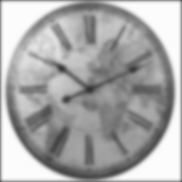
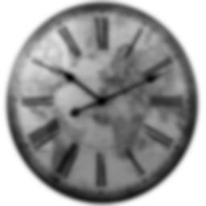


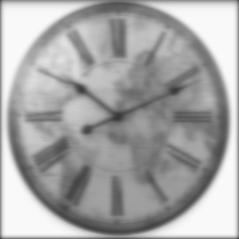
Applying
Naive Gauss Method
Multiplication Method
Only Rows first
Applying Cols Convolution
Original Image

Slide 4

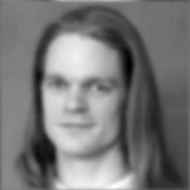
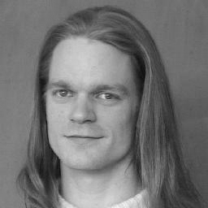
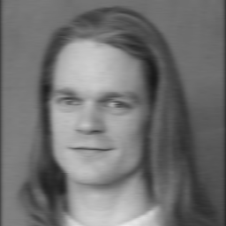

Naive Gauss Method
Multiplication Method
Only Rows first
Applying Cols Convolution
Original Image

Slide 5
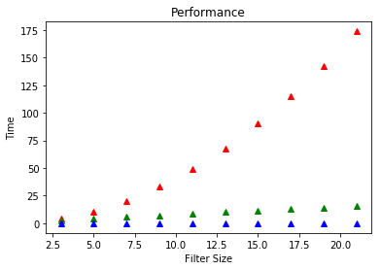
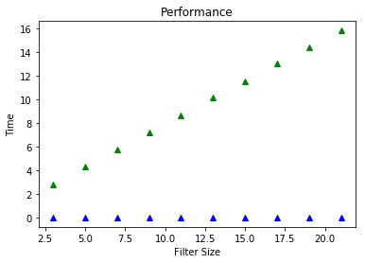
Performance Measurement
Time in sec Comparing the last two further
Red - Naive Approach Green: Separable Approach
Green - 2 1D Array Approach Blue - Gaussian Filter (using
Blue - Gaussian Filter (using Multiplication) Multiplication)

Slide 6


Task 2.2:Gradient Images
Task: Perform image gradient by using the following two properties

Slide 7
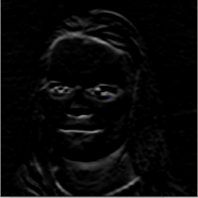
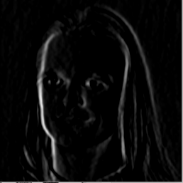
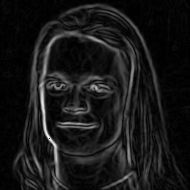
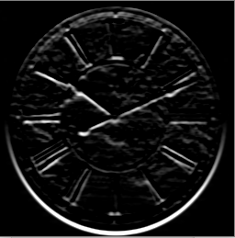
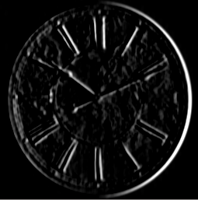
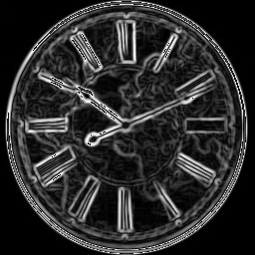
Image gradient of the gaussian blurred image
kernel size: 5x5
Gradient x axis
Gradient y axis
Gradient magnitude

Slide 8
Image blurred with the gradient kernel
kernel size: 5x5

Slide 9
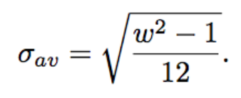
Gaussian Kernel size vs sigma
Given a box / average filter of width w x w, the equivalent standard deviation to apply to achieve roughly the same effect
http://www.peterkovesi.com/papers/FastGaussianSmoothing.pdf

Slide 10
Task 2.3 : Implement a recursive filter
First talking about the Separability :
A 2D kernel, if separable, can be represented as two 1D kernels to be applied across axes. Since gaussian filter can be separated, we evaluate the 1D Kernels which needs to be applied consecutively.
This will result in faster evaluation compare to 2D kernels (without using internal functions which are highly optimized)

Slide 11


Recursive Filter : which re-uses one or more of its outputs as an input.
Example :
y[n] = Ay[n − 1] + Bx[n] -> Recursive
y[n] = Ax[n − 1] + Bx[n] -> Non-Recursive
We use Recursive Filter with two component Causal & Anti-Causal
Causal
Anti-Causal
After Evaluating the Causal & Anti-Causal filter coefficients, we apply the filter on the Images consecutively across axes.

Slide 12
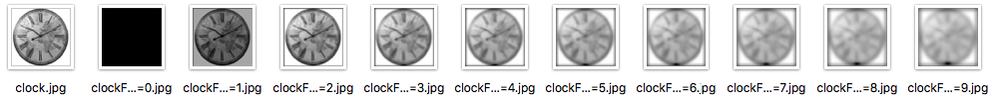
Results :
Learnings :
Duration : 2 mins for 10 different sigma values
2. When standard deviation is zero we see blank instead of smooth image’

Slide 13
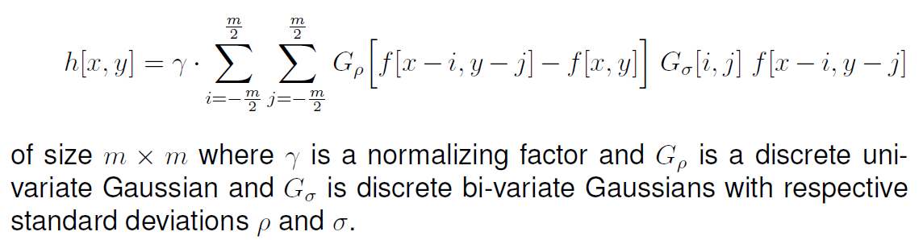
Task 2.4: Implementation of Bilateral filter
Here is a Bilateral filter

Slide 14
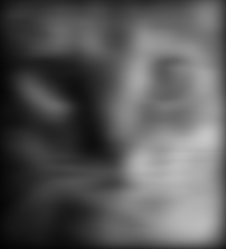

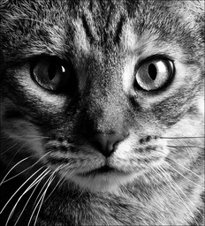
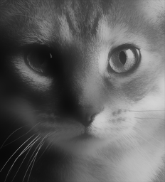

Applying on Image
Only Smoothing, Gaussian Filter(sigma 10)
Original Image
Edge Preserving, Bilateral Filter (sigma 10, ro 100)

Slide 15
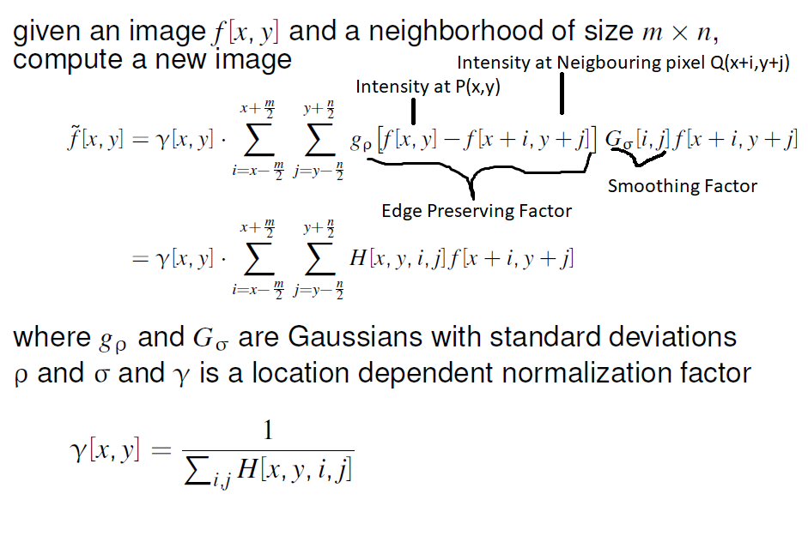
Notes:
Input to the Edge preserving factor is bivariate, that’s why we can’t separate it. Since, Gamma is location dependent normalization factor, we have to calculate it again and again.

Slide 16





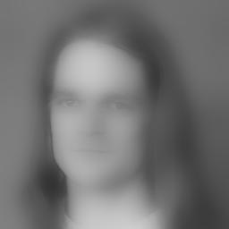
sigma=1.5
sigma=5
sigma=10
ro=10
Original Image
ro=100
Computation Time: 1hr 13 minutes
Notes:
Total time took Looks like nothing is happening in the upper right corner, but we need to zoom in for details.

Slide 17
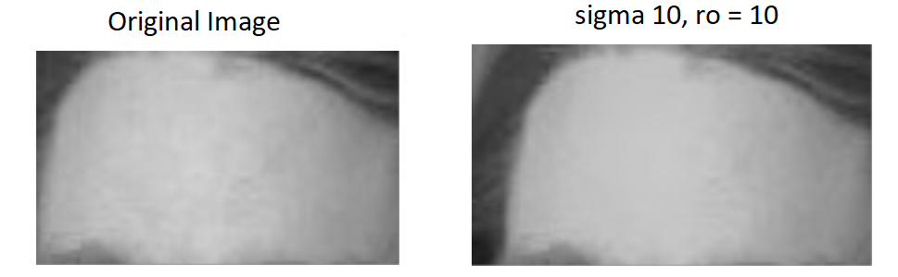
Deep Analysis
Notes:
Right side image is more smooth compared to the original one.

Slide 18



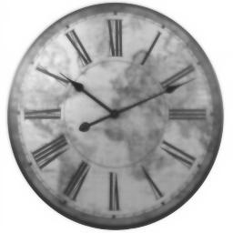

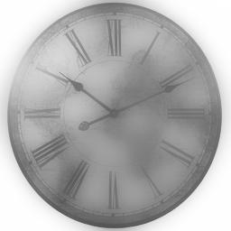
sigma=1.5
sigma=5
sigma=10
ro=10
Original Image
ro=100
Computation Time: 1hr 42 minutes

Slide 19
Thank You

